Slide 1

Apprenticeships

Slide 2
Strategic choices and unique insights
A uniquely comprehensive list of apprenticeships in the UK.
Enhanced research
  Significantly speeds-up and supports your research into apprenticeship opportunities.
Expectations met
  Unique filtering and ranking facilities enabling you to focus on key areas of interest.
The Benefits

Slide 3
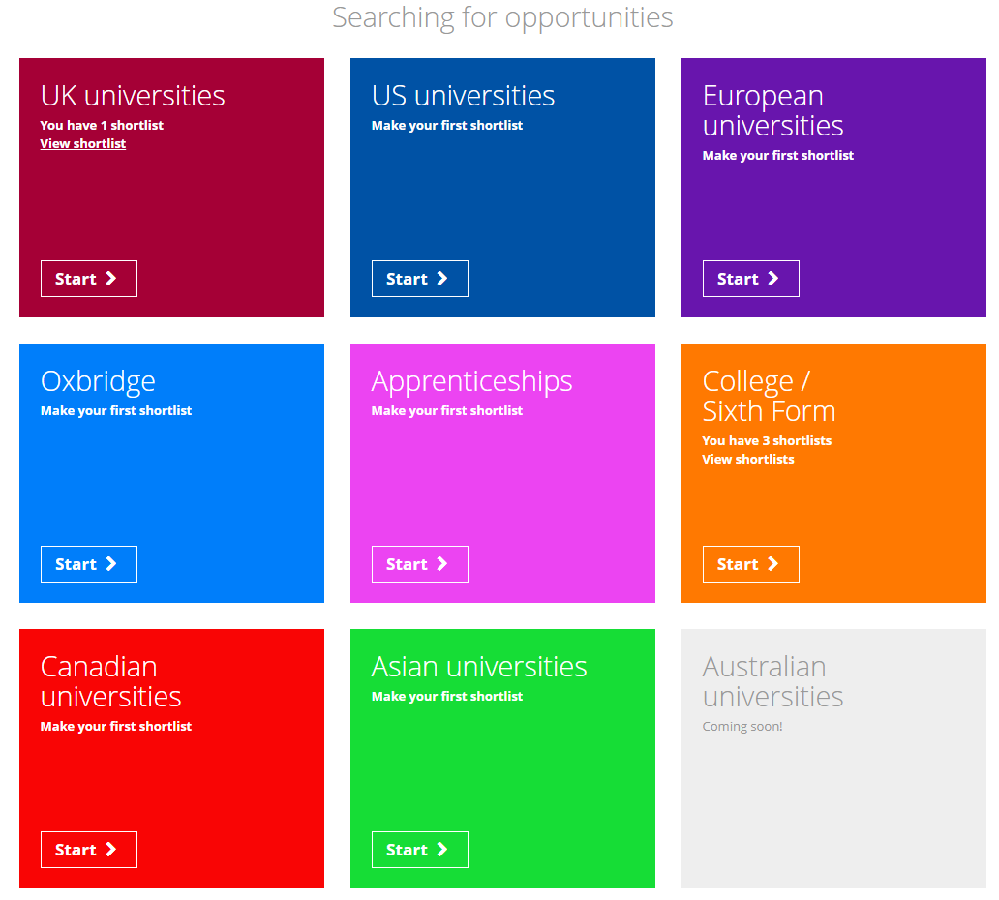
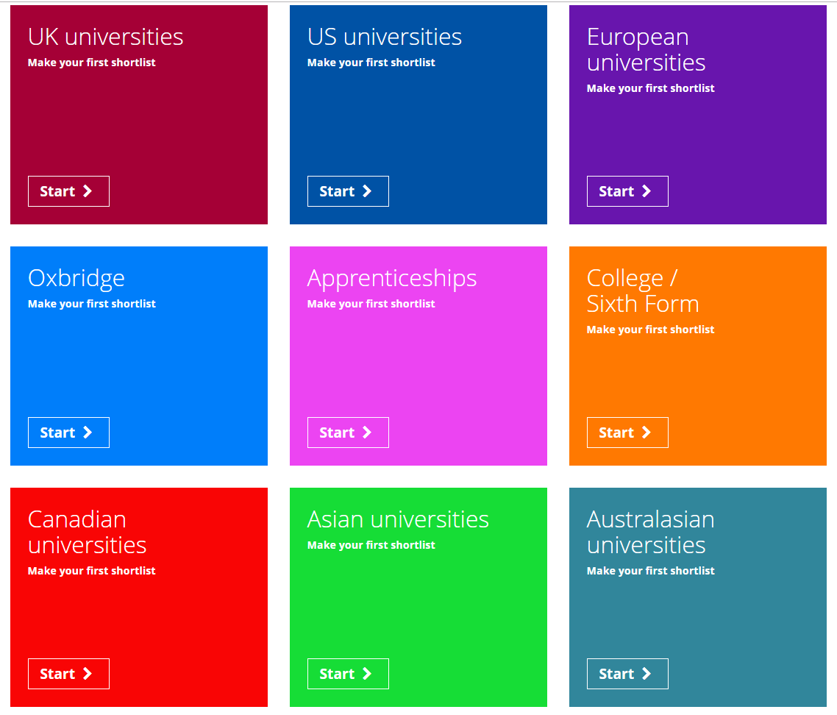
From the student dashboard at unifrog.org/student/home, click ‘Start’ on the Apprenticeships box.

Slide 4
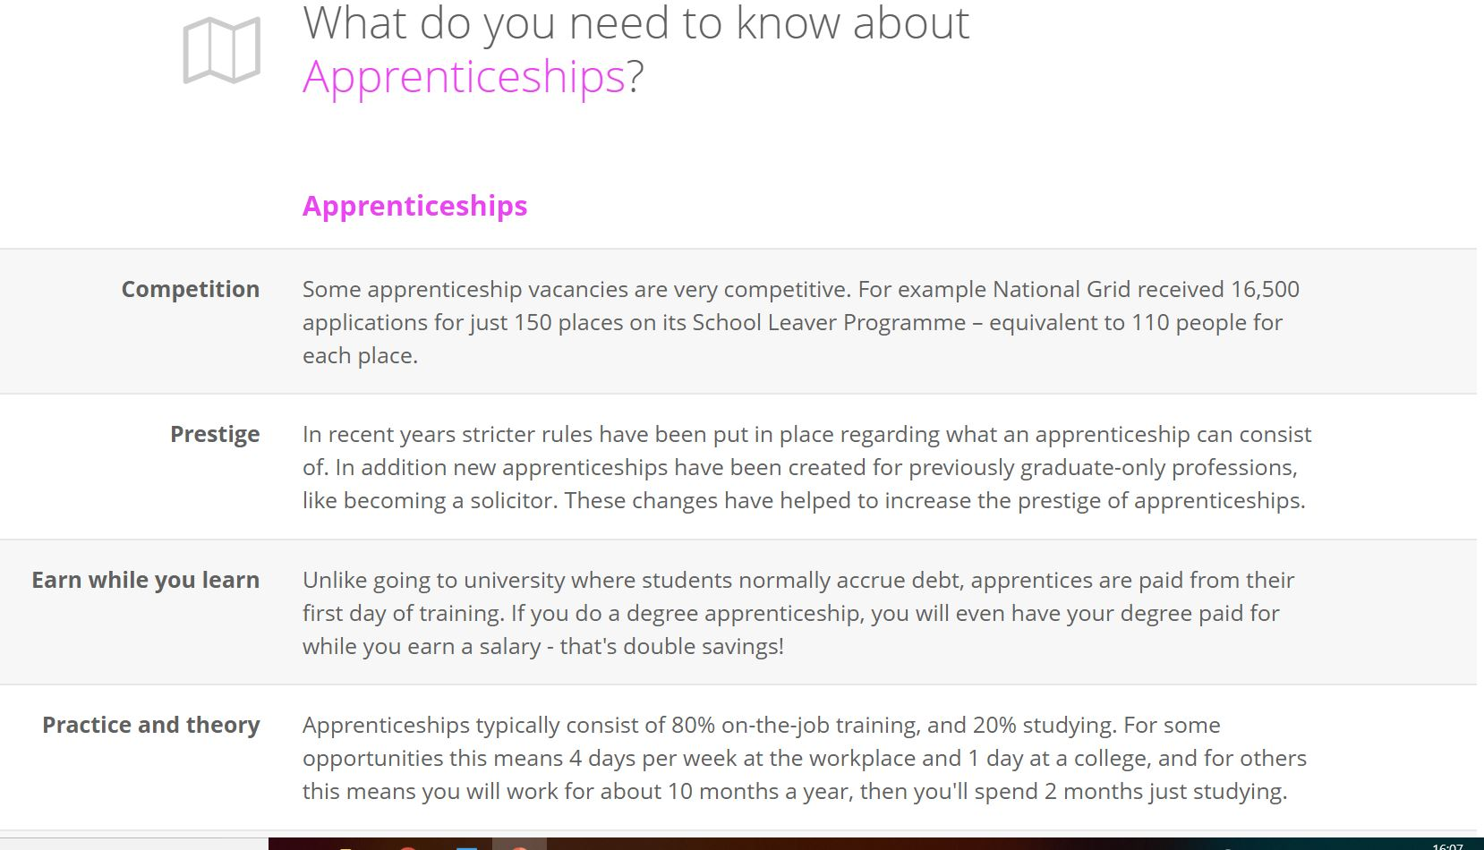
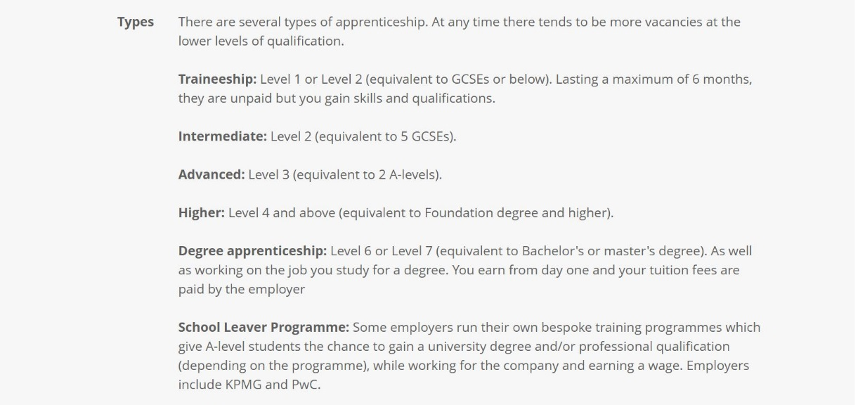
Please familiarise yourself with some of the important details about apprenticeships.
You need to take these factors into consideration when making your applications.
Once you have finished reading, click ‘Next’ at the bottom of the page.

Slide 5
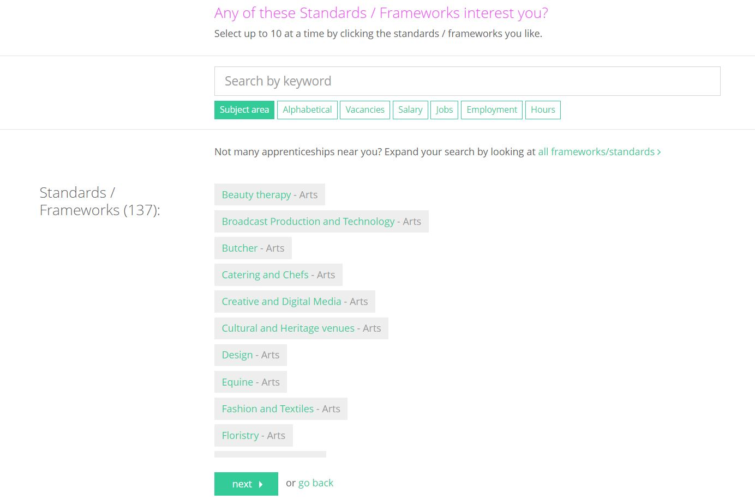
You will see a list of Standards/Frameworks that you can do an apprenticeship in. Select those that interest you, up to a maximum of 10.
You can rank the Standards/Frameworks using the different options or search for a keyword.
When you are happy with your choices click ‘Next’.

Slide 6
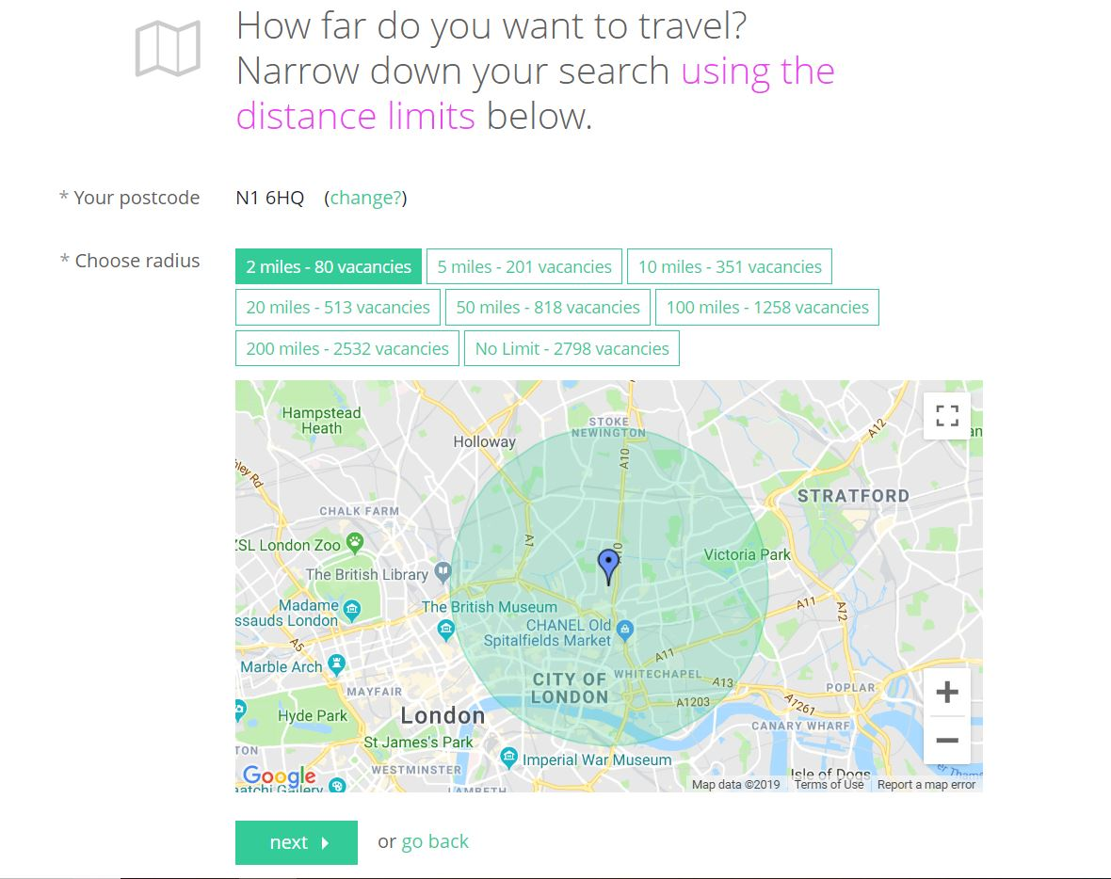
Now that you have selected certain Standards/Frameworks, you are able to narrow this search even further by distance.
Using your postcode and distance limits, you can decide how far you would like
to travel.
When you are happy with your choice click ‘Next’.

Slide 7
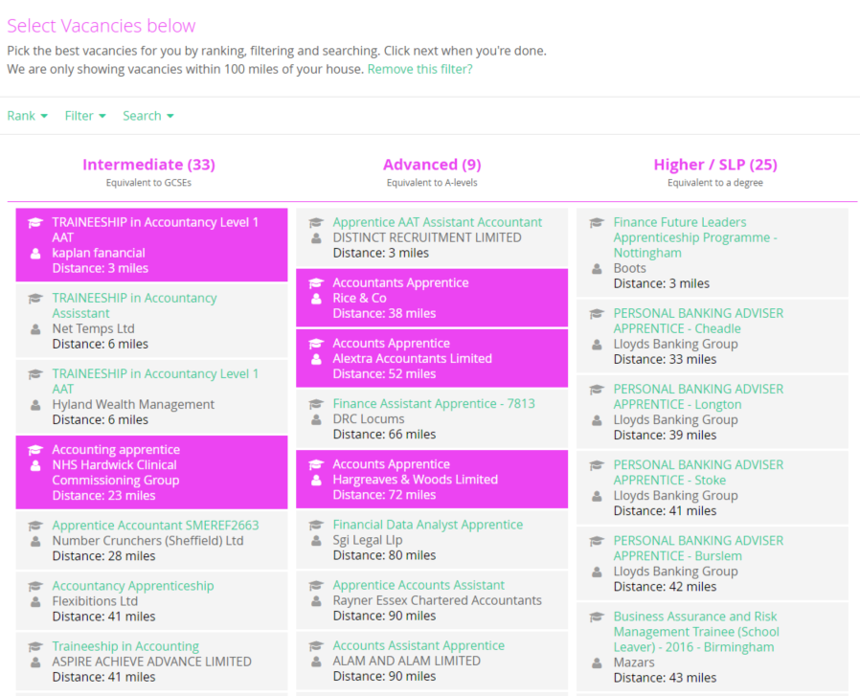
This page shows all the apprenticeships that match your chosen Standards/Frameworks and distance limits .
Make sure to consider which level of apprenticeships you are researching.
You can rank and filter courses to find the ones that suit you best.
Click ‘next’ to continue.

Slide 8
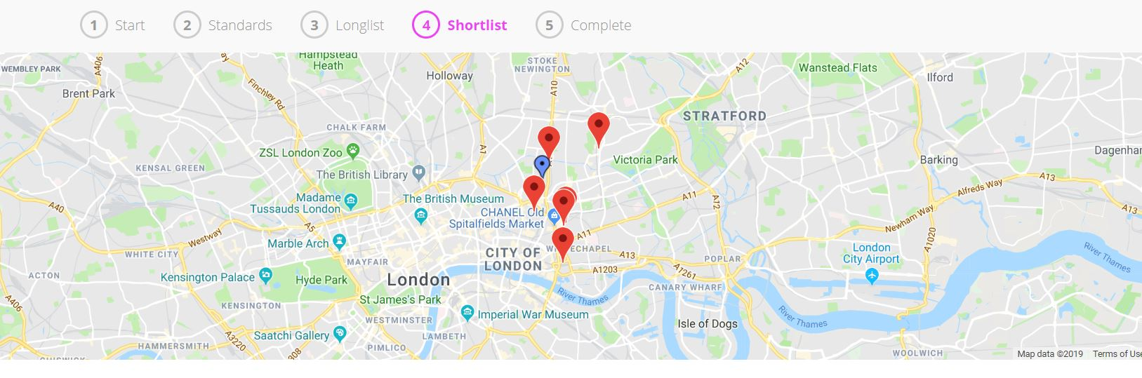
The map shows you the location of the apprenticeships you have selected that appear on your Shortlist. This is particularly important if you are going to be commuting from home.

Slide 9
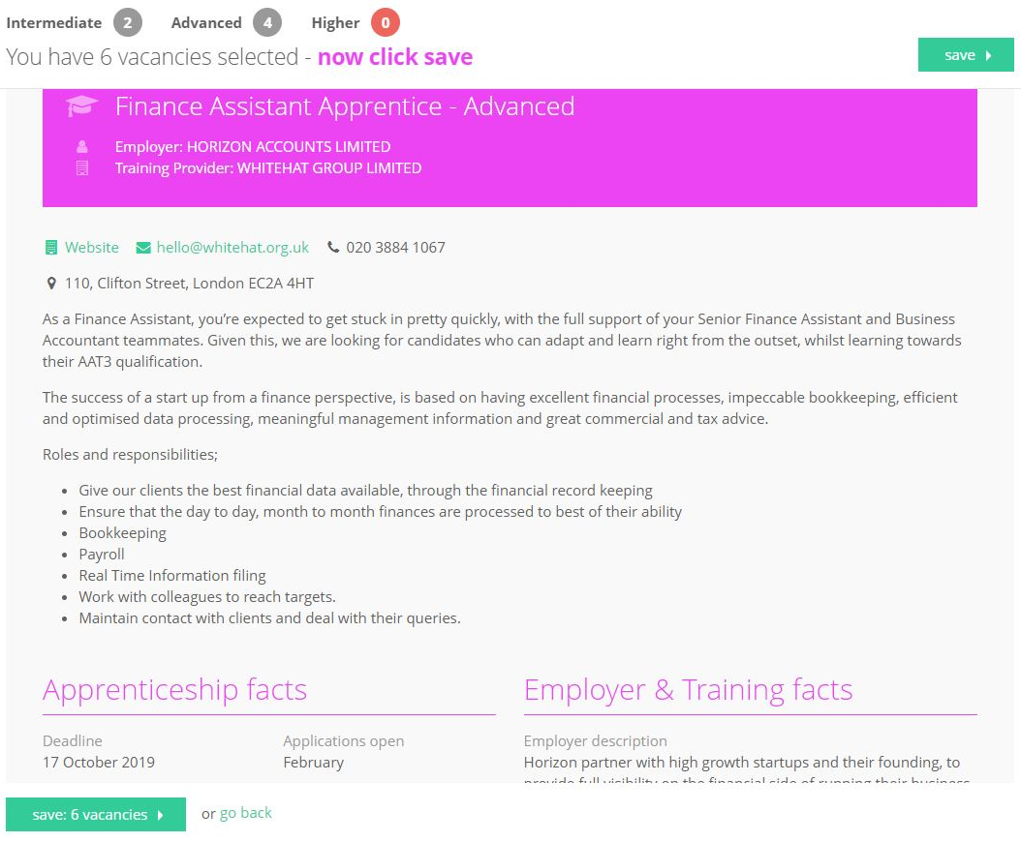
Scrolling down allows you to see lots of detailed impartial information about each apprenticeship, including the training provided and qualifications you will receive.
Don’t forget that at any point you can go back to edit your choices, and you can also delete courses from your shortlist!
Once you’re happy with the courses on your Shortlist page, click ‘save’.

Slide 10
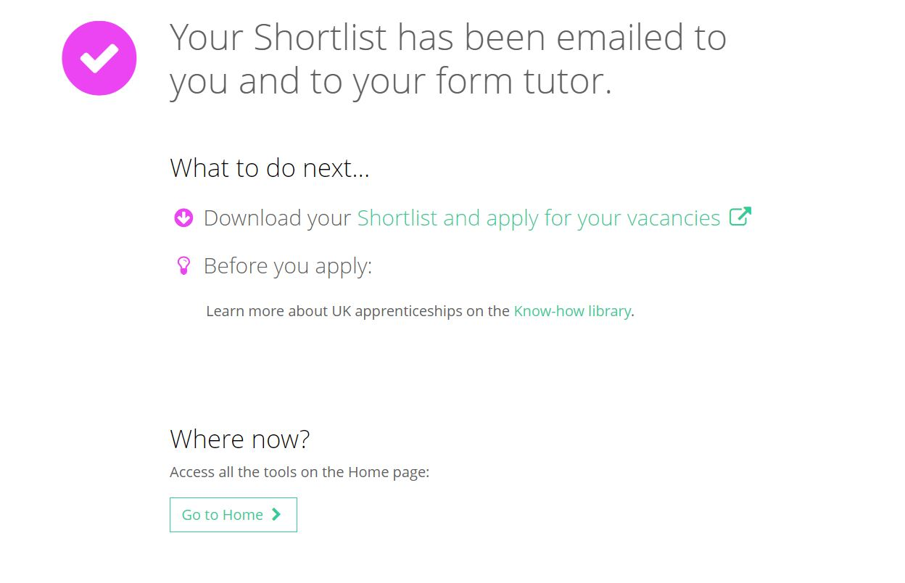
A copy of your Shortlist will be emailed to you as well as your tutor.
You can download your Shortlist and also apply for your chosen apprenticeships by clicking ‘Shortlist and apply for your vacancies’.
You can also gain further information on UK apprenticeships from our Know-how library before applying.

Slide 11
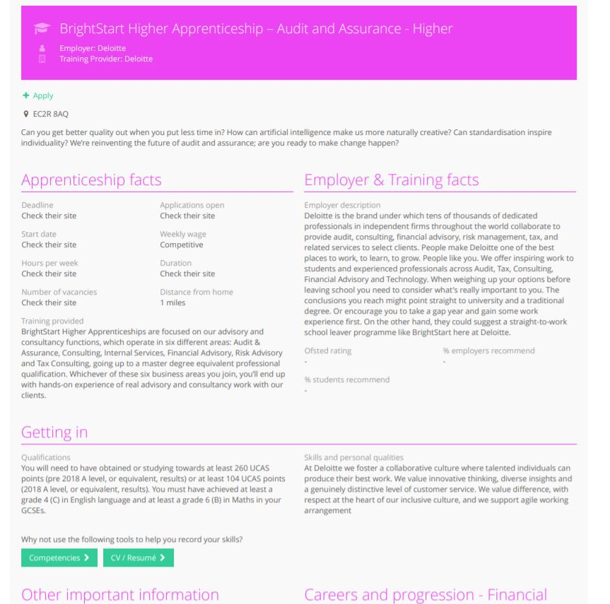
The Shortlist shows you detailed information about each vacancy; make sure you scroll down to see it all.
You can use the ‘+Apply’ button to navigate directly to the appropriate website and apply for the vacancy immediately.
You can also be taken directly to the ‘Competencies’ and ‘CV/Resume’ tools on the platform which will support you in your applications.

Slide 12
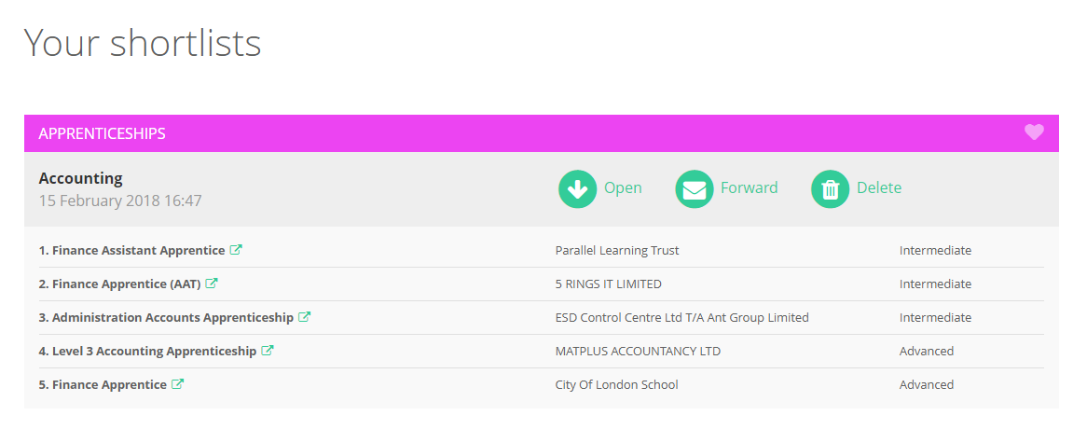

Remember, you can make as many Shortlists as you like and can view them any time by clicking on the Shortlist button on the main dashboard.

Slide 13



