Slide 1

Careers library

Slide 2
The Benefits
Comprehensive research
    An extensive, searchable database of over 800 different job profiles featuring a wealth of information.
Smart search options
    Explore job roles by favourite subject, key skills, career area or theme.
Unique insights
    Hear directly from people who are actually working in specific careers and industries.

Slide 3
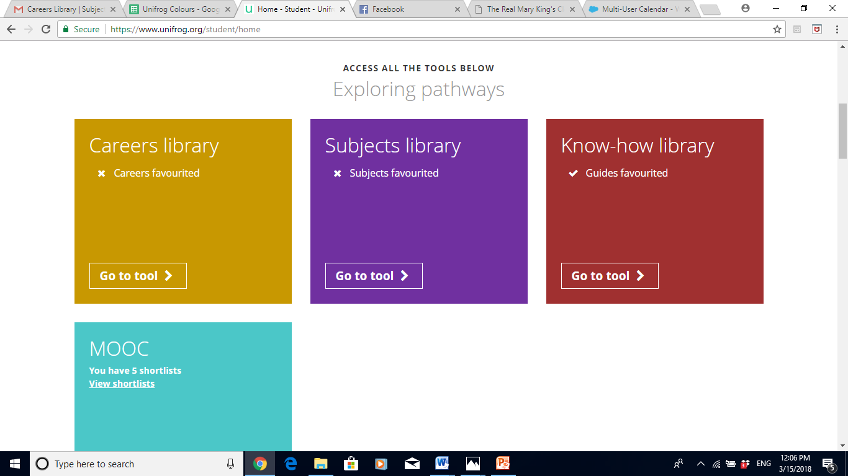
From the student dashboard at unifrog.org/student/home, click ‘Go to tool’ on the Careers library box.

Slide 4
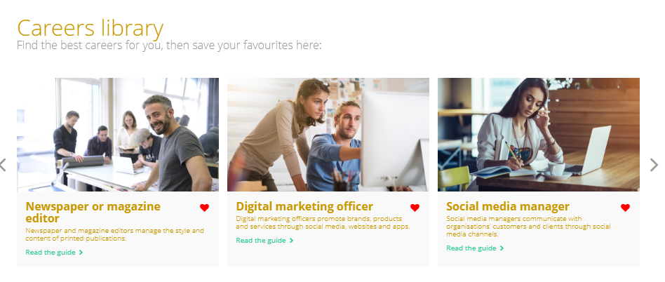
More than 800 job profiles are featured on the careers library! Your favourites will be stored at the top of the page, for easy access.

Slide 5
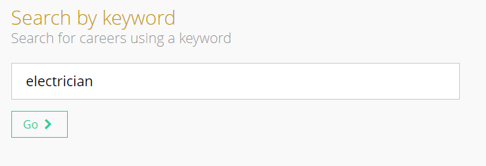
Use the smart searching options on the library homepage to access and explore different career profiles suited to your particular needs and interests.
First of all you can search by a keyword using the text box provided.

Slide 6
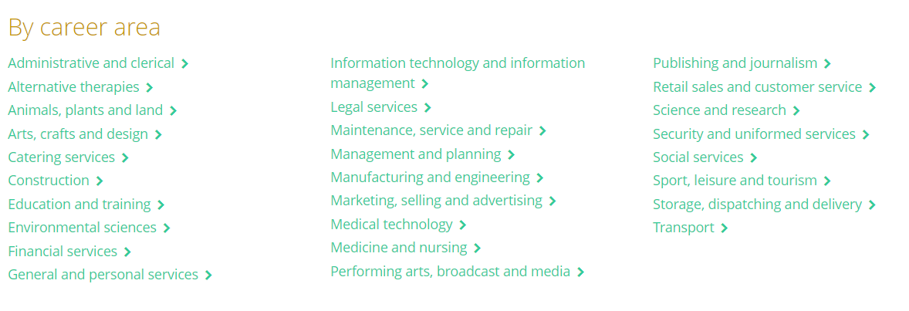
You can also search by a particular career area you are interested in finding out more information about e.g. Legal services or Publishing and Journalism.

Slide 7
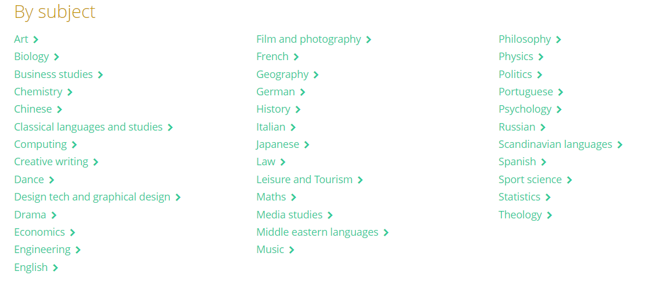
Searching ‘By subject’ will allow you to explore careers in a subject you may find particularly interesting at school or are considering taking at university.

Slide 8
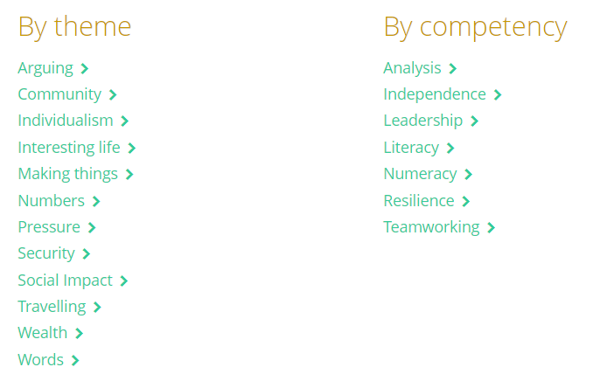
Finally, you can search by a theme which may interest you (such as ‘Travelling’) or a key competency which you may feel particularly confident in.

Slide 9
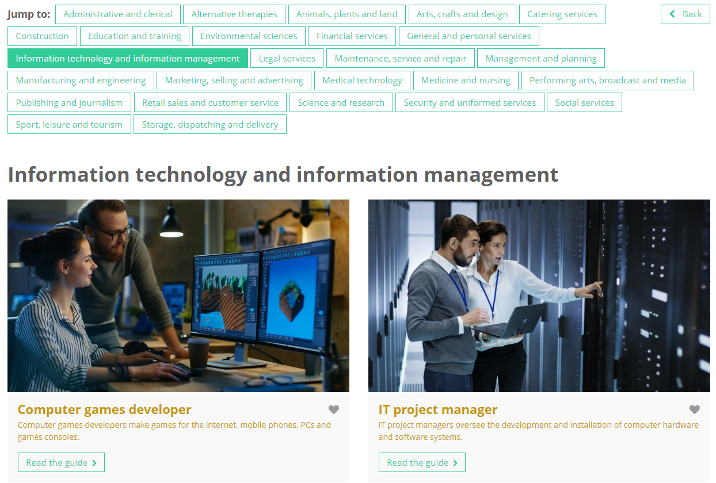
Searching by career area will provide an overview of that particular sector, and the types of skills you will need to be successful.
Explore the industry in terms of low paid, medium paid and high paid job roles.

Slide 10
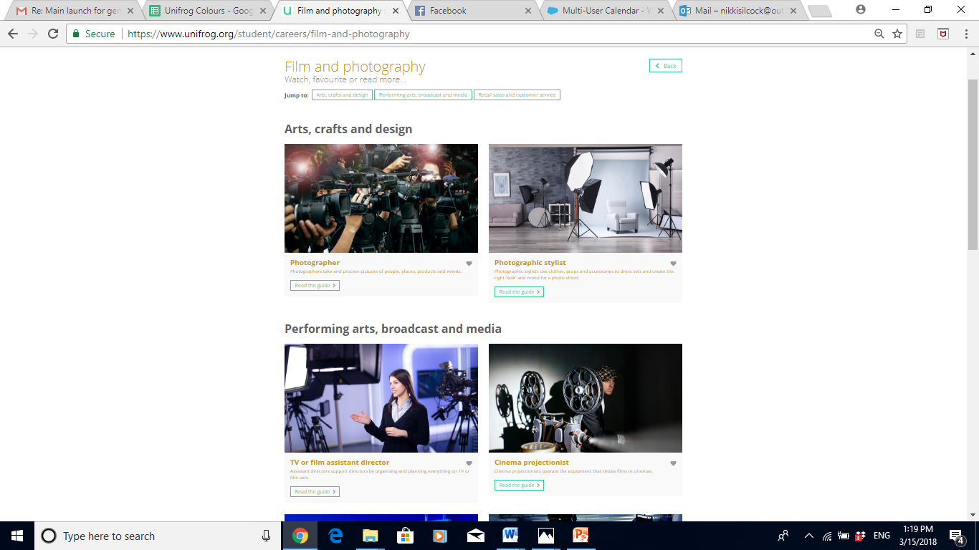
Searching by either a keyword, subject, theme or competency will return several related career areas which allow for quick and targeted research.
Specific career role profiles will feature under each career area. Click ‘Read the guide’ to find out more information.

Slide 11

Each guide contains a career summary, followed by information on areas such as earning potential, future job prospects, day-to-day responsibilities, and what exactly you’ll need to get there.
Make sure you scroll down the page to find out lots more great information!

Slide 12
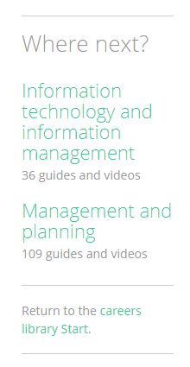
Each profile also contains links to other career areas which may interest you, based on the area you are currently looking at.

Slide 13
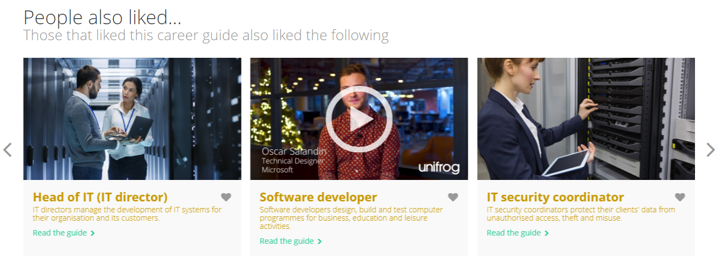
At the bottom of the page, you will find a range of career guides suggested for you, based on what other people have liked alongside this particular career

Slide 14


