Slide 1

Know-how Library

Slide 2
The Benefits
Comprehensive research
    An extensive database of hundreds of guides and videos to help you research and successfully apply for your best next step after school.
Targeted advice
    Get practical advice & tips on specific issues, from how to write a Personal Statement for an architecture course, to what’s involved in studying in Spain!
Unique insights
    Hear directly from people who have previous experience in and an insight of the pathways you’re considering.

Slide 3
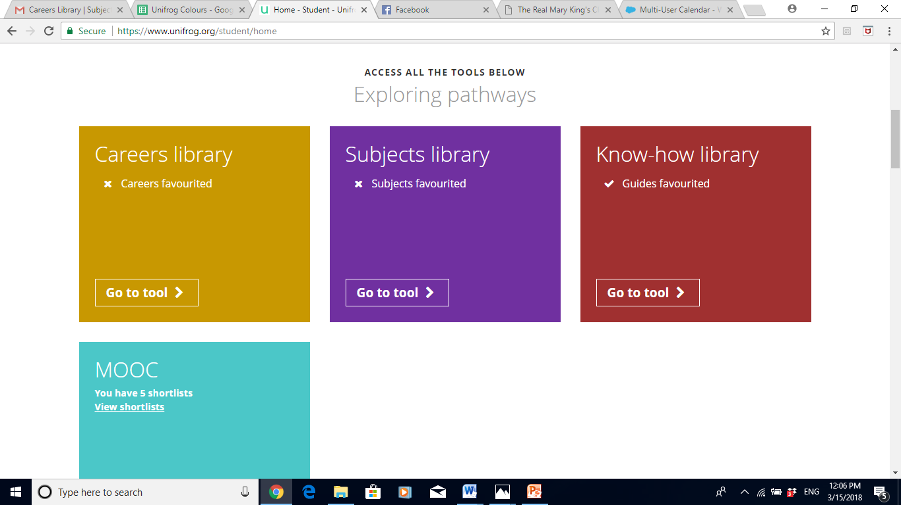
From the student dashboard at unifrog.org/student/home, click ‘Go to tool’ on the Know-how Library box.

Slide 4
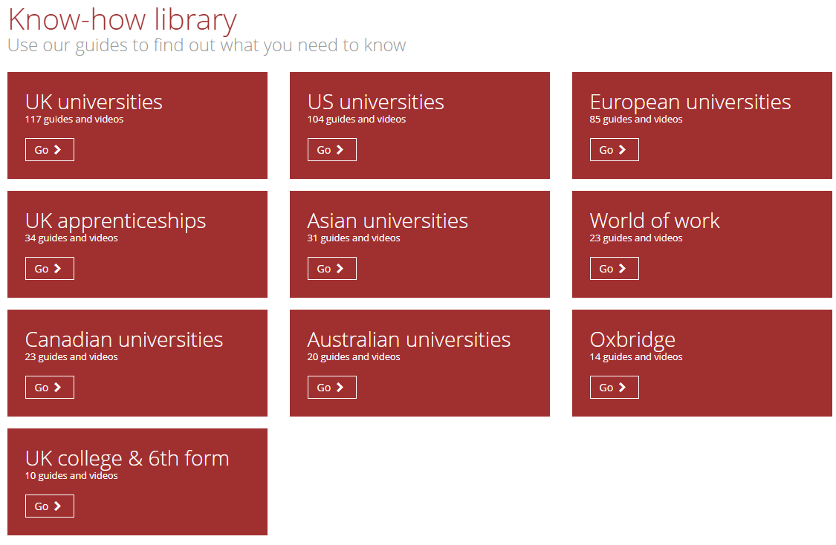
There are hundreds of guides and videos within the library, stored across different categories, with each relating to different pathways. Click ‘Go’ on whichever category you would like to explore.

Slide 5
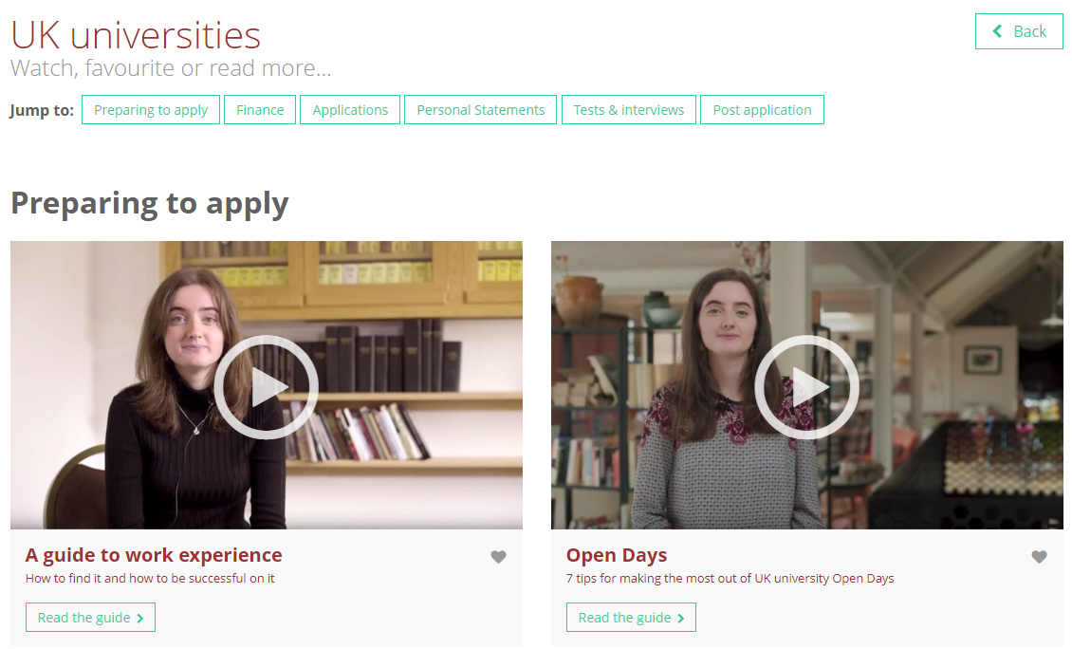
Your selection will return several related sub-categories which allow for quick and targeted research.
Specific information related to each sub-category will feature underneath each sub-heading. To find out more about these particular topics, click ‘Read the guide’.

Slide 6
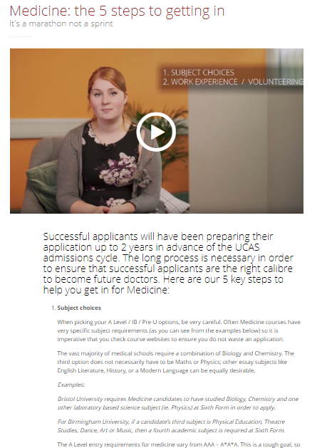
Each guide contains a wealth of information on your chosen topic.
You will find plenty of tips, advice and useful statistics to help you to successfully prepare and apply for your chosen pathway.
Many guides feature useful videos for further insight.

Slide 7
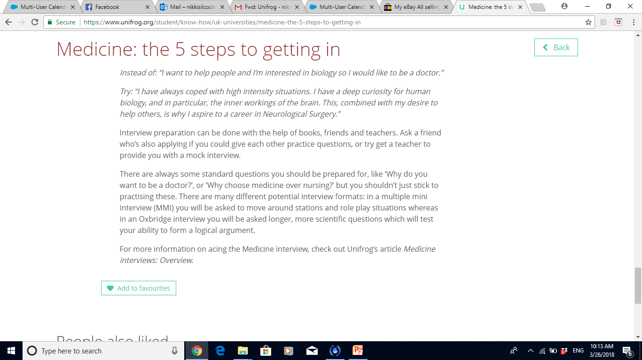
At the bottom of each guide, there is an option to add it to your favourites, so that it can be easily retrieved for future reference.

Slide 8
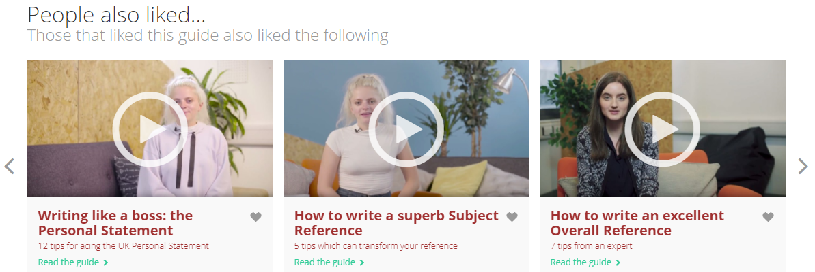
The library will also suggest a range of related reading material, and show you what others have liked, based upon your selection.

Slide 9
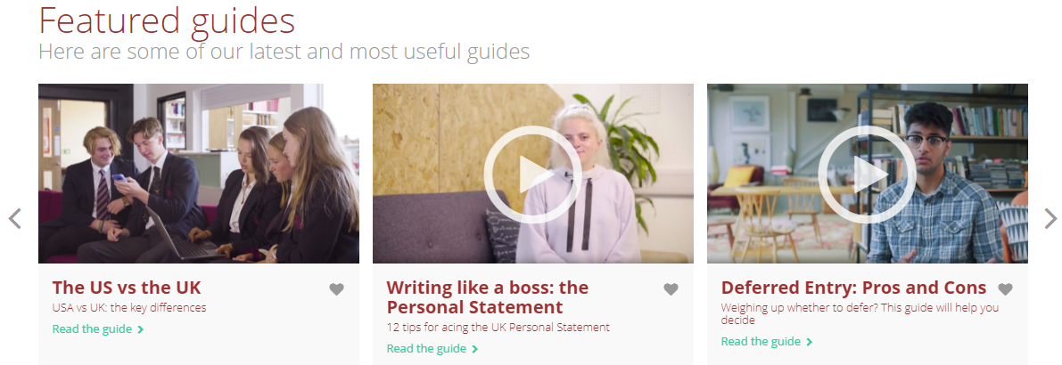
If you’re not sure where to start, you might want to check out some of the most recent and useful guides, featured in the middle of the Know-how library home page.

Slide 10
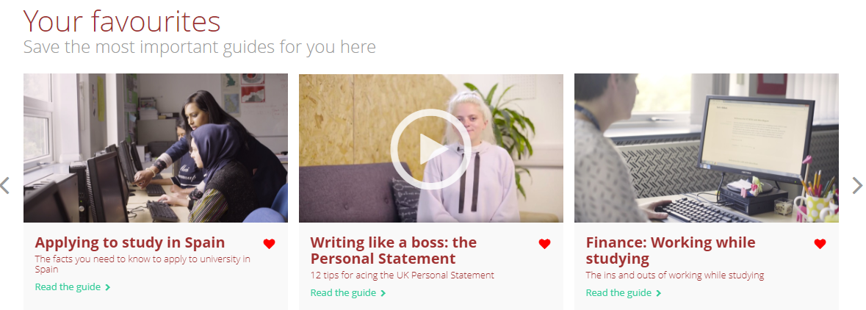
More than 200 guides are featured on the Know-how library! Any you have marked as a favourite will be stored at the bottom of the page, for easy access.

Slide 11


